Slide 1

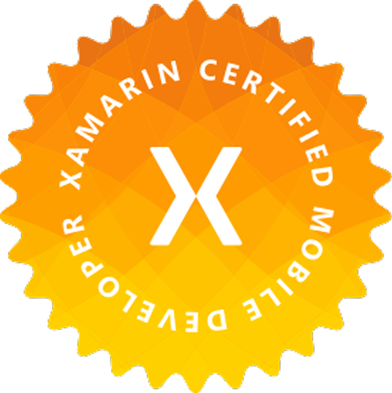
Cross-platform Mobile Development
With Xamarin and Visual Studio
Winston Gubantes
Independent .NET / Xamarin Developer
Notes:
Im Winston, im an independent .NET / Xamarin Developer. I got over 5 years of mobile development experience starting with Windows Phone for 2 years and over 3 years for Xamarin Mobile development.
Today will gonna talk about Xamarin Mobile Development using Visual Studio 2017.

Slide 2
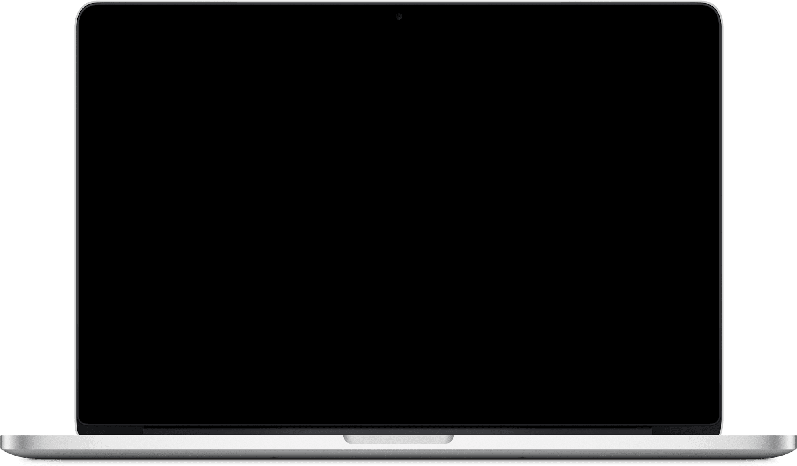
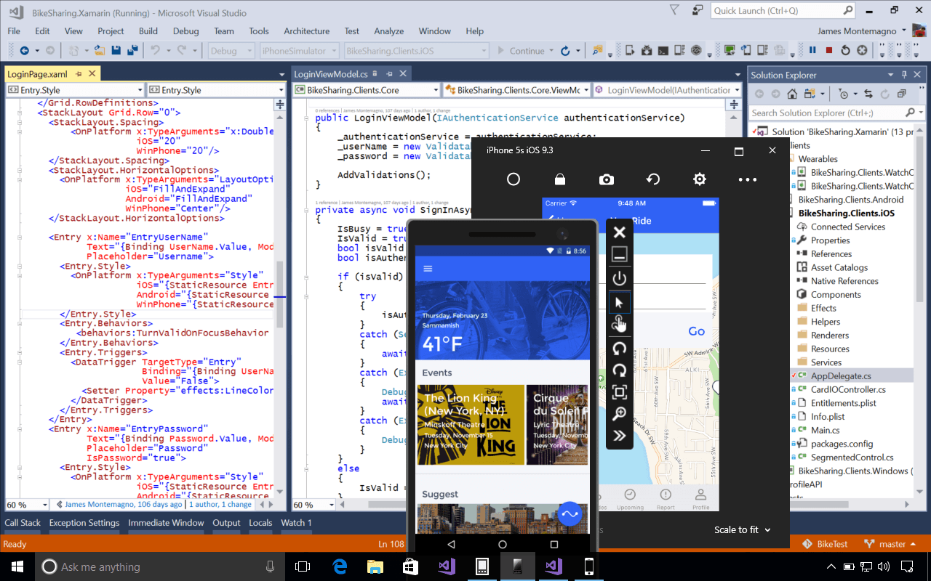
Things needed
Visual Studio 2017
Mac Build Host
Notes:
Before diving into Xamarin mobile development, This is the tools do we need to develop xamarin mobile apps.
Don’t you worry guys, at the bottom of this presentation there is guide on how to install this tools.

Slide 3

Discuss
Visual Studio
C#
XAML
MVVM
Platforms - Android, iOS, UWP
Notes:
There are lot of articles that talks about how to get started, but before you get started, you need to know if this is exactly for you. Atleast basic knowledge on the list so you can fast track on understanding the mobile development process. Because its becoming steeper to learn xamarin if you have no basic knowledge on this list.

Slide 4
Comparison
View
XAML
HTML
ViewModel / Controller
Mobile Backend
Web Backend
Model
Mobile Backend
Web Backend
Notes:
I have made a simple illustrations here on why learning Xaml is just as important as learning html. And MVVM pattern just like MVC it utilizes separation of concern and makes your application unit testable.
Most part of our discussion we will only be using one type of page that is “ContentPage” and we will talk about layouts and how to make beautiful apps out of it.

Slide 5
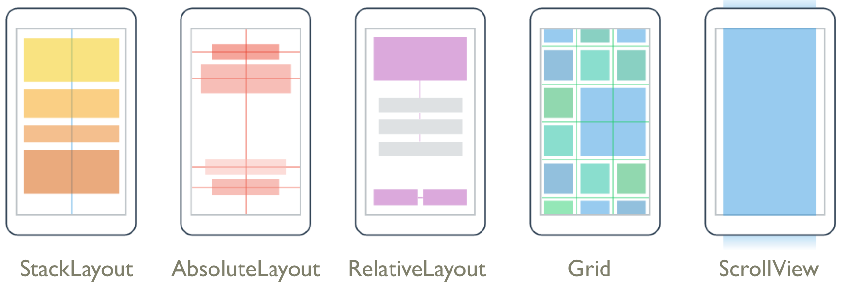
XAML Layout
Notes:
Now start with Xaml Layout, We will discuss on how to create beautiful layouts, and we will also showcase some tips and tricks on our demo.
Based on my experience I have only used atleast 3 layouts extensively in my entire career as a Xamarin developer, namely StackLayout, Grid and ScrollView. Of course you can have nested layouts and you can interchange the hierarchy depending on the design requirements.

Slide 6

Stacklayout
Notes:
We always set our StartUp project per platform in our sample we set .Android project as the starting project. And the entry point of the app happens in App class constructor were the MainPage property is set.
StackLayout is the simpliest layout, it organizes views in a one-dimensional line ("stack"), either horizontally or vertically. Basically it is good for data entry like login form or data entry form, I have provided a video on how you can play around your layout using “Live Run”.

Slide 7
Absolutelayout
Notes:
Absolutelayout, unlike Stacklayout it can have an overlapping child elements, you can also have its elements bounds be proportional or absolute to the layout. I have provided another video to make it understandable.
LayoutBounds and AbsoluteLayoutFlags properties are the key to have a combination on how the layout interprets.

Slide 8
Relativelayout
Notes:
Very much like an Absolutelayout the only difference is it does not have the concept of the moving anchor and does not have facilities for positioning elements relative to the bottom or right edges of the layout, which means it can go beyond the layout bounds. For me it is the most complex layout because its driven by constraint expression. I have provided a minimal sample of the layout in this video.

Slide 9
Grid
Notes:
The Grid layout should not be confused with traditional tables and is not intended to present tabular data. Grid does not have the concept of row, column or cell formatting. Unlike HTML tables, Grid is purely intended for laying out content.

Slide 10
ScrollView
Notes:
contains layouts and enables them to scroll offscreen. ScrollView is also used to allow views to automatically move to the visible portion of the screen when the keyboard is showing. Can only contain one children.

Slide 11
Tips and Tricks
Notes:
Here is a few tips and tricks video I have made, This are the tricks I have used over the years as a Xamarin Developer. This one is just a simple one without using a custom-renderer, because most of the time im using custom renderer which is quite more advance topic.

Slide 12
Question?
Notes:
Before we proceed to MVVM Pattern, do you have any question about layout?

Slide 13
MVVM Pattern Motivation
It provides separation of concerns
It enables a developer-designer workflow
It increases application testability
Notes:
1.) It provides separation of concerns. Tightly coupled, change resistant, brittle code causes all sorts of long-term maintenance issues that ultimately result in poor customer satisfaction with the delivered software. A clean separation between application logic and the UI will make an application easier to test, maintain, and evolve. It improves code re-use opportunities and enables the developer-designer workflow.
2.) It enables a developer-designer workflow. When the UI XAML is not tightly coupled to the code-behind, it is easy for designers to exercise the freedom they need to be creative and make a good product.
3.) It increases application testability. Moving the UI logic to a separate class that can be instantiated independently of a UI technology makes unit testing much easier.

Slide 14
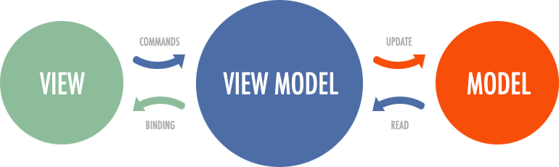
MVVM Pattern
UI and UI Logic (Code Behind)
Entities
Presentation Logic
Notes:
There are lot of articles that explains MVVM in detail and its history and its pros and cons, I have provided a simple diagram. So you can see that ViewModel acts as an intermediary between the view and model. A Viewmodel contains bindable properties that is binded to the view, What it means that everytime the view changes the value it will notify the Viewmodel tru a Property Changed Event. A View should only contain a single Viewmodel where the later may contain multiple models. So lets take a look on the next slide.

Slide 15
MVVM in action
Notes:
Will be using the layout we discussed earlier which is the login layout as our example. So the view in this case is already done, We will now implement the viewmodel for our view. Show Views, ViewModel and Model in project.

Slide 16
MVVM Frameworks
PRISM
MVVM Light
Fresh MVVM
ReactiveUI
Notes:
I wish I could discuss it you in depth detail, but we still have exercises after this, so I will just list here the popular mvvm frameworks and what I have used over the years. During early years I was using MVVM light but I found as the application grows and the need for the application to be testable I have shifted to PRISM, Which I have been using until this day. I am not endorsing it but it is for you to find out which one will fit to your coding needs.

Slide 17
Why should use MVVM Framework?
Navigation
Dependency Injection
Maintainability
Notes:
When your application gets bigger, or has a larger team, it becomes harder to manage, and due to a lack of separation of concerns, can cause headaches maintaining and upgrading it.

Slide 18
Question?
Notes:
Before we proceed to Exercises, do you have any question about MVVM?

Slide 19
Exercises
Notes:
We will just do a simple exercise, this is to familiarize the environment and getting to know Mr. XAML and Xamarin Previewer feature.

Slide 20
Resources
Beautiful Pre-Built App – Link Here
Nice Looking Xamarin Apps – Link Here
Awesome Xamarin – Link Here
Lottie Animation – Link Here
Xamarin Developers Davao – Link Here
Mobile .NET Developers - Philippines (MONDPH)
Xamarin Forms Made Easy – Link Here
Xamarin Developers – Link Here
Notes:
So I have listed the resources which I think can help us go further with advance topics.

Slide 21
Thank you and
Happy Coding!
Notes:
I Hope that we will have another session like this which may tackle advance topics and we could a poll which topics needs to be discuss. I hope you guys enjoy the session. Thank You and Happy Coding.

